Slide 1
Reinforcement Learning in Finance
Erdem Ultanir
QuantMinds, 2018

Slide 2
Outline
What is reinforcement learning?
Examples in finance
Review of toolset
OpenAI, Tensorflow, Keras
Demonstrate how to build a skeleton trading gym+agent with 3 discrete actions

Slide 3
Machine Learning
Supervised learning: Goal is prediction. We provide a set of training data including the input and output, then train a model that can predict the output from an unseen input. E.g. Logistic regression, random forests
Unsupervised learning: Goal is pattern extraction. When we provide a set of data that has no output, the algorithm will try to extract the underlying non-trivial structure within the data. E.g. Nearest neighbor
Reinforcement learning: Goal is creating response to environment, mimic human-learning. We use a trial-and-error approach to find out what actions will produce good outcomes and bias our preference towards those good actions.

Slide 4

Reinforcement Learning
Episode: A sequence of (s1, a1, r1, s2, a2, r2, s3, a3, r3 ... st, at, rt ... sT, aT, rT).
Reward rt: The agent receives after taking action at a state at time t.
Return: Cumulative reward since the action is taken (sum of rt, r[t+1], ... rT).
Value: Expected return at a particular state, called state value or V(s), or the expected return when taking action a at state s, called Q value or Q(s,a).
The optimal policy can be formulated as choosing action a* and the amount of all choices of a at state s such that Q(s, a*) is the maximum.

Slide 5
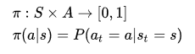
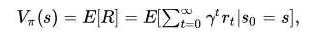
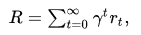
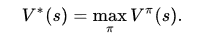
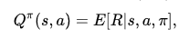
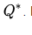
Some notation
Policy; gives probability or deterministic action a when we end up in state s.
Value function
Maximum of value function can be found with different policies, end gives the optimal policy
Q value is returns expected return given state and action
And optimal Q value

Slide 6
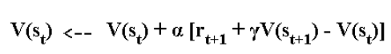
Solutions
Monte Carlo methods are slow to converge, not scalable to large problems
Temporal difference formulation is used to estimate value functions
On-policy: uses a policy to take actions, but uses soft/greedy/softmax-ordered actions to explore. SARSA
Off-policy: algorithms can update the estimated value functions using hypothetical actions, those which have not actually been tried. An off-policy method may end up learning tactics that it did not necessarily exhibit during the learning phase. Q-learning

Slide 7
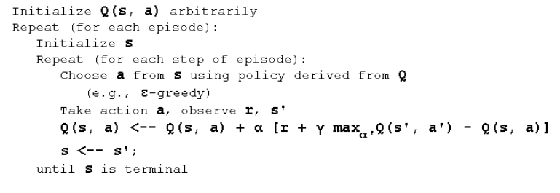
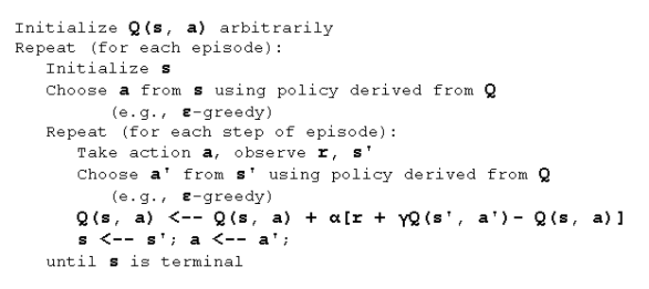
Solutions
Q-learning
Q values are updated based on estimates
SARSA
Takes an additional action on policy to update Q value

Slide 8
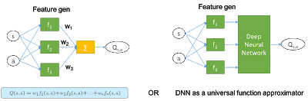
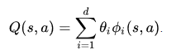
Solutions
Q values are estimated through neural networks
There are also policy search algorithms
Suffer with noisy data,
Stuck in local minimas if gradient descent is used. Actor-critic approaches are designed to improve (A3C/DDPG)
Notes:
An actor whose job is to improve the policy function by tuning the policy function parameters.
A critic whose job is to fine tune the estimation of Q value based on current (incrementally improving) policy.
A3C asyncronohous advantage actor critic
DDPG: deep deterministic policy gradients

Slide 9
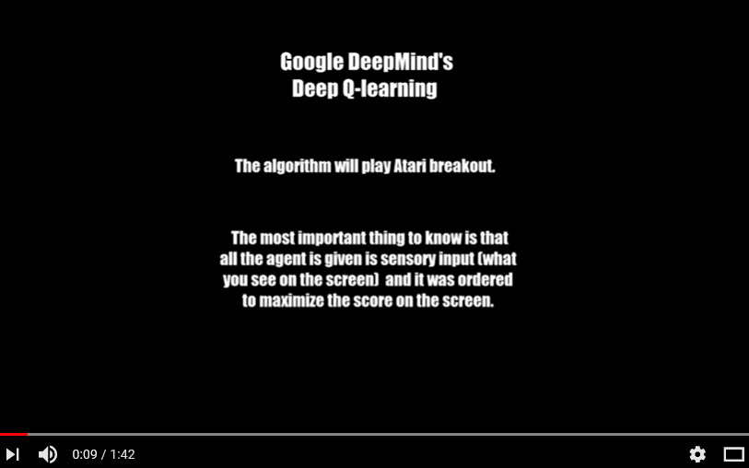
Applications & Tools
Reinforcement learning is currently succesfully applied game or game like simulation environments (enclosed)
Google-backed startup DeepMind Technologies has built an artificial intelligence agent that can learn to successfully play 49 classic Atari games by itself, with minimal input (25 Feb 2015). Learn the games from pixels
In October 2015, AlphaGo became the first computer Go program to beat a human professional Go player without handicaps on a full-sized 19×19 board.[2][3] In March 2016, it beat Lee Sedol in a five-game match, the first time a computer Go program has beaten a 9-dan professional without handicaps.
The distributed version in October 2015 was using 1,202 CPUs and 176 GPUs!

Slide 10
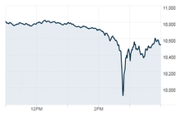
RL in finance
Trading
Environment is not enclosed
Portfolio management
States; prices, announcements, tweets, GDP reports, etc. It is quite difficult to bring all the information together even to create a training dataset, and even more difficult in the live environment.
ID mapping
Feed disruptions
Errors in feeds
Does history always repeat itself?
Etrading, optimize trade execution instead of direct usage of VWAP, TWAP strategies
DJIA May 6, 2010

Slide 11
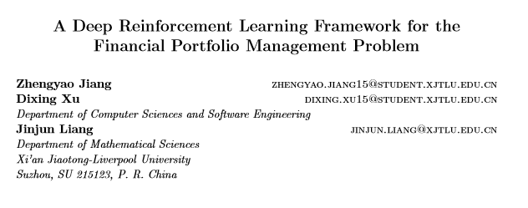
RL problems with discrete actions in video games and board games cannot be directly applied to portfolio selection problems where actions are continuous
Continuous deep RL framework actor critic Deterministic Policy Gradient algorithms (Silver 2014, Lillicrap 2016). Continuous output is achieved by a neural network approximated policy function and second network trained as reward function estimator. Training two networks is difficult.
Proposes; ensemble of Identical Independent Evaluators; inspect history of each asset separately and provide a score which will be proportional to its action

Slide 12
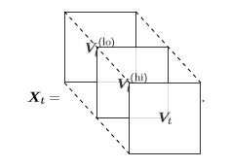
Uses a feature length of 3; closing, highest, lowest, n=50 (30 min period; total a day and an hour) crypto currency prices.
11 different currencies
All prices are normalized with latest closing price
Also previous portfolio weights are fed-in
Reward function total return in a period

Slide 13
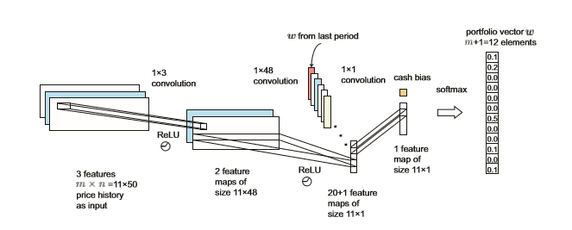
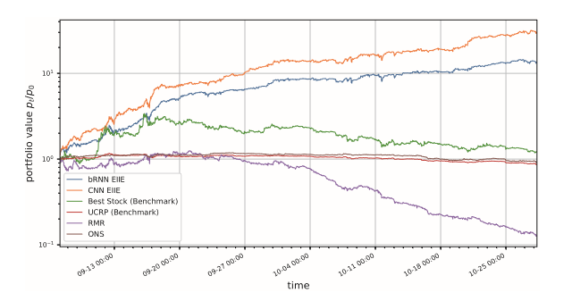
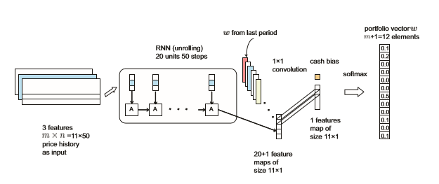

Slide 14
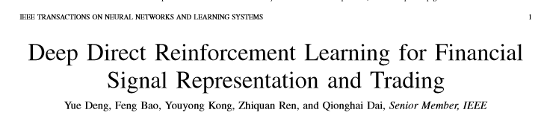
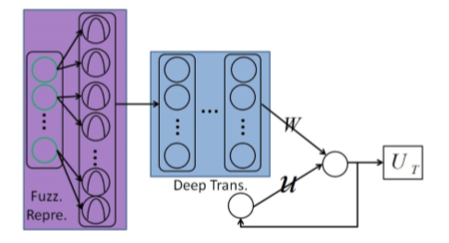
Fuzzy Deep Reinforcement Learning
Fuzzy membership functions are used in the inputs to reduce the noise impact to the training
Features are historical returns and last position
The ﬁrst strategy is the widely used early stopping method for DNN training. The system is only trained for 100 epochs with a gradient decreasing parameter be ηc =0.97.
Second, model selection to select a good model for the out-of-sample data. 15000 training points are divided into two sets as RDNN training set (ﬁrst 12000) and validation set (last 3000). On the ﬁrst 12000 time points, FDDR is trained for 5 times and the best one is selected on the next 3000 blind points (5 fold validation). Such validation helps to exclude some highly overﬁtted NNs from the training set.

Slide 15
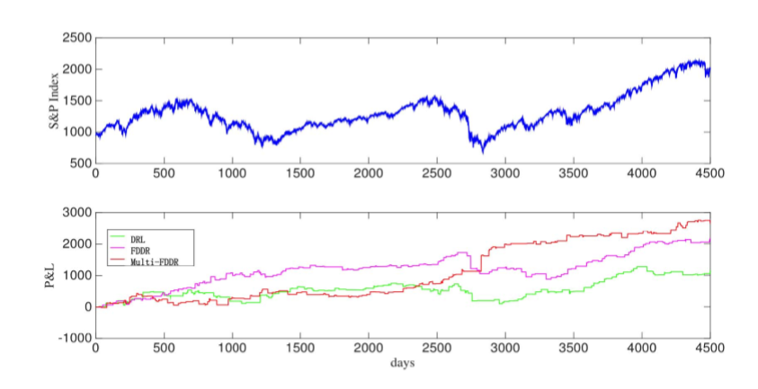
FDDR performs better than a single layer reinforcement network (DRL)
Additional feature set (global stock indices) reduces the model performance. Not deep enough, hyper-parameters, training length?

Slide 16
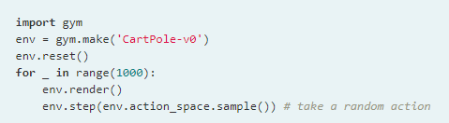
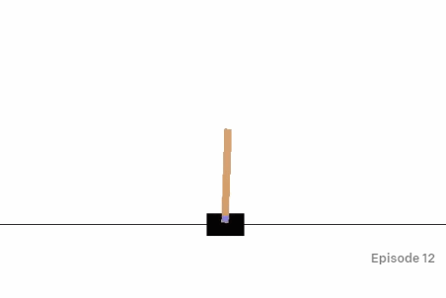
Open AI Gym
Gym is an answer to
The need for better benchmarks.
Lack of standardization of environments used in publications .
Actions and rewards are standardized, and the environment is same for all agents

Slide 17
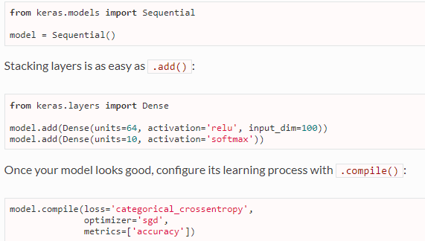
Keras+Tensorflow
Keras is a high-level neural networks API, written in Python and capable of running on top of TensorFlow, CNTK, or Theano. It is modular, simple
Tensorflow is a symbolic vector math python library which allows to optimize the calibration of weights of the neural network. Low level interface to the neural network design is possible. Provides autodiff( AAD) for gradient calculation

Slide 18
Keras-RL
Provides agents using Keras
https://github.com/keras-rl/keras-rl/issues
Documentation is poor but examples are provided that integrate with open-ai gym environments
Name | Observation Space | Action Space
DQN | discrete or continuous | discrete | Double Q learning | https://arxiv.org/abs/1509.06461
DDPG | discrete or continuous | continuous | Deterministic Policy Gradient Algo (actor-critic) | https://arxiv.org/pdf/1509.02971v2.pdf
NAF | discrete or continuous | continuous | continuous variant of the Q-learning algorithm, which we call normalized adantage functions (NAF) | https://arxiv.org/abs/1603.00748
CEM | discrete or continuous | discrete | Cross entropy method/Monte Carlo method | http://learning.mpi-sws.org/mlss2016/slides/2016-MLSS-RL.pdf
SARSA | discrete or continuous | discrete | State action reward state action
Notes:
Deep Q-learning[edit]
The DeepMind system used a deep convolutional neural network, with layers of tiled convolutional filters to mimic the effects of receptive fields. Reinforcement learning is unstable or divergent when a nonlinear function approximator such as a neural network is used to represent Q. This instability comes from the correlations present in the sequence of observations, the fact that small updates to Q may significantly change the policy and the data distribution, and the correlations between Q and the target values.
The technique used experience replay, a biologically inspired mechanism that uses a random sample of prior actions instead of the most recent action to proceed.^{[2]} This removes correlations in the observation sequence and smoothing changes in the data distribution. Iterative update adjusts Q towards target values that are only periodically updated, further reducing correlations with the target.^{[19]}
Double Q-learning[edit]
Because the maximum approximated action value is used in Q-learning, in noisy environments Q-learning can sometimes overestimate the action values, slowing the learning. A variant called Double Q-learning was proposed to correct this.^{[20]} This algorithm was later combined with deep learning, as in the DQN algorithm, resulting in Double DQN, which outperforms the original DQN algorithm

Slide 19
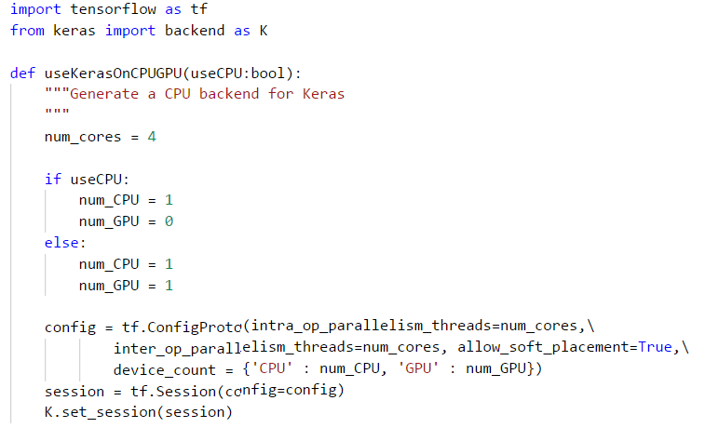
CPU vs GPU vs TPU
You will often have interactions with the environment in between learning steps, which will often be better off running on CPU than GPU. So, if your code for taking actions and your code for running an update / learning step are very fast (as in, for example, tabular RL algorithms), it won't be worth the effort of trying to get those on the GPU.
Big neural network, that you need to go through whenever you select an action or run a learning step (as is the case in most of the Deep Reinforcement Learning approaches that are popular these days), the speedup of running these on GPU instead of CPU is often enough for it to be worth the effort of running them on GPU (even if it means you're quite regularly ''switching'' between CPU and GPU, and may need to copy some things from RAM to VRAM or the other way around)
tensor processing unit (TPU) is an AI accelerator application-specific integrated circuit (ASIC) developed

Slide 20
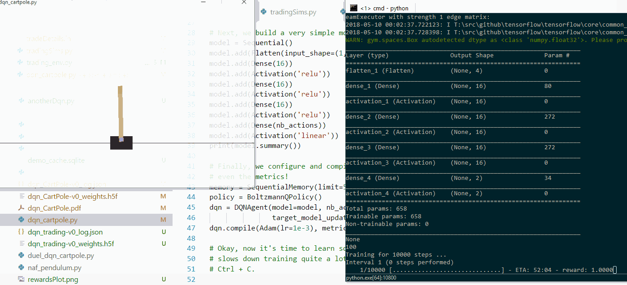
Keras-RL with Open AI Gym
dqn_Cartpole.py
cartPoleEdited

Slide 21
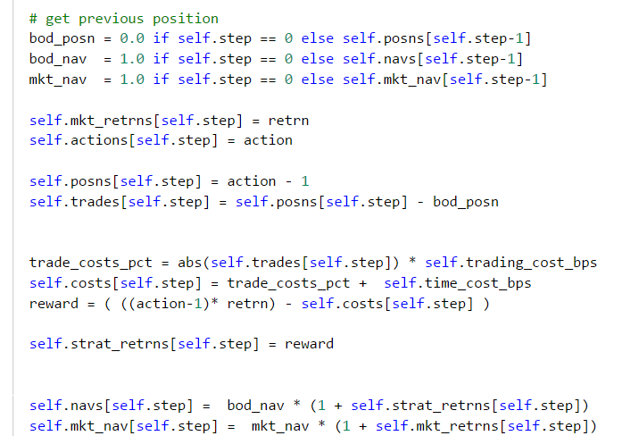
Keras-RL with Trading Gym
t-1
t
State is observed
at end of step,
and reward is
calculated
costs are integrated based on action
action
action

Slide 22
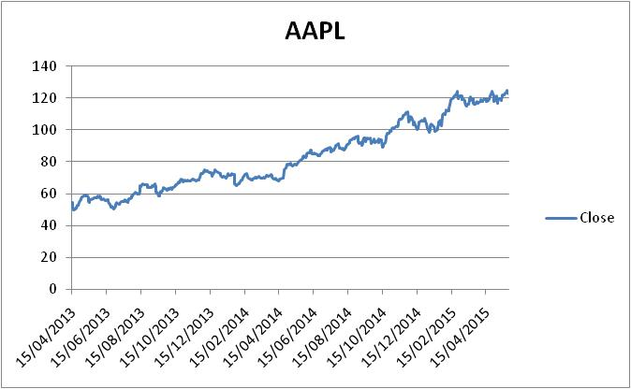
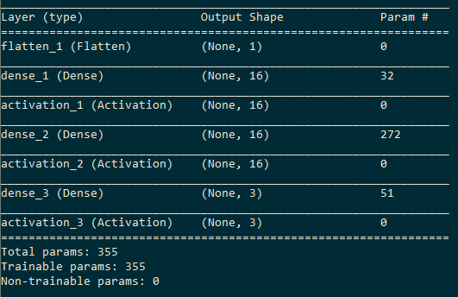
Test framework
Single stock training
Training mini-batch size is one month (20 days)
Mini-batches randomly sampled from the historical time series
Neural net is two layer with each layer having 16 cells.

Slide 23
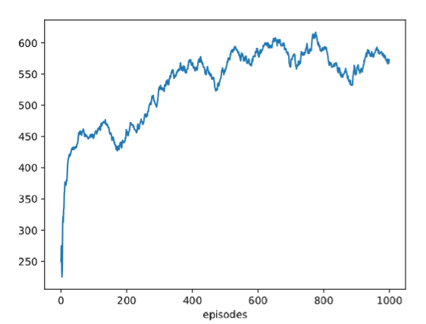
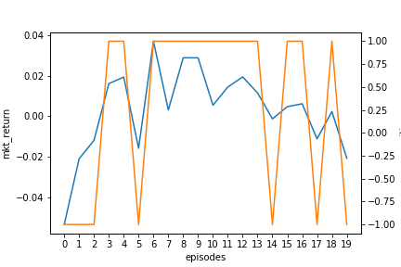
Test #1
Feed future prices as inputs to test the learning ability of the algorithm,
fit on a single static mini-batch
Verify if the code has bugs
Optimize neural network (two layers one hidden)
Number of episodes
Simplify the reward function, if sign of returns and position is same get reward of 50
Trade directions follow the sign of market returns, perfect trades!
steps

Slide 24
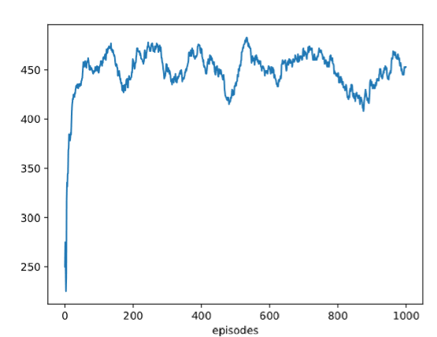
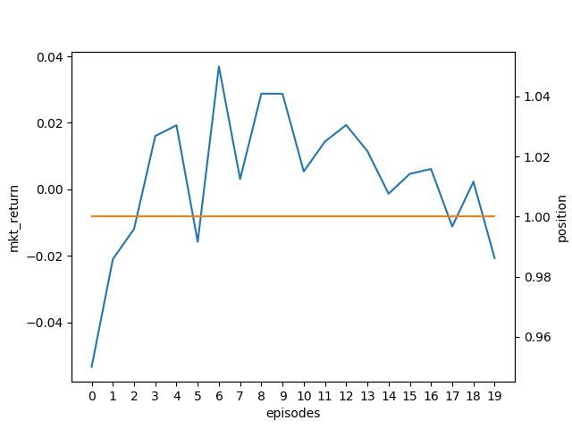
Test #2
Remove future prices from the inputs
Turns into long only portfolio, given that most of the returns in this period is positive, it is an ok answer
steps

Slide 25
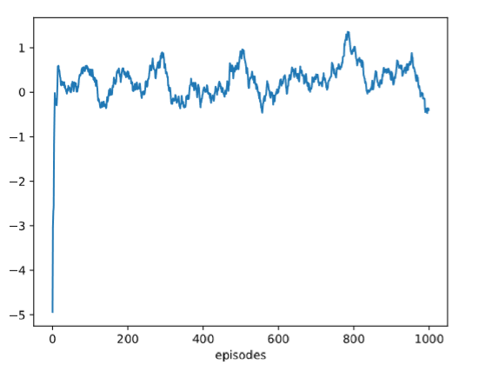
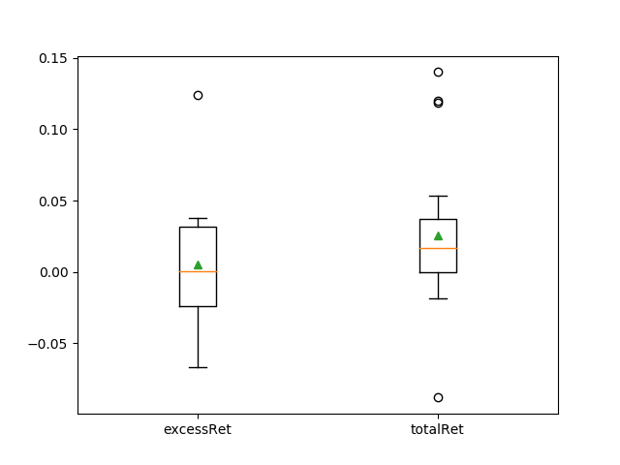
Test #3
Randomize train and test mini batches
Zero cost case
Reward scaling seems to help convergence reward*50 ☺
Excess returns (NAV(T)-MNAV(T)) are not that impressive, it beats the market 50% of the time, though mean is positive

Slide 26
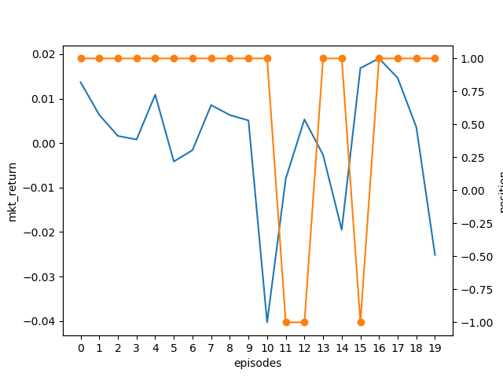
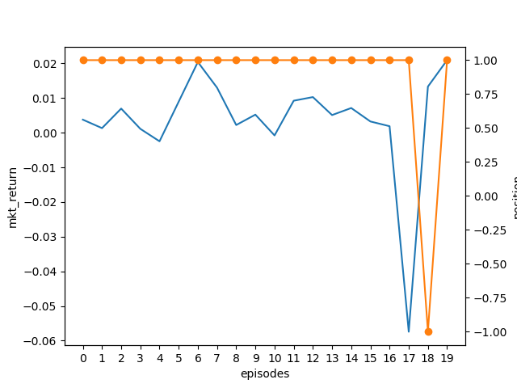
Test #3 continued
steps
steps
Trades seems to capture delayed trend information from the market, ex short after negative return, and long in positive. If persistent market returns this algo will be successful.

Slide 27
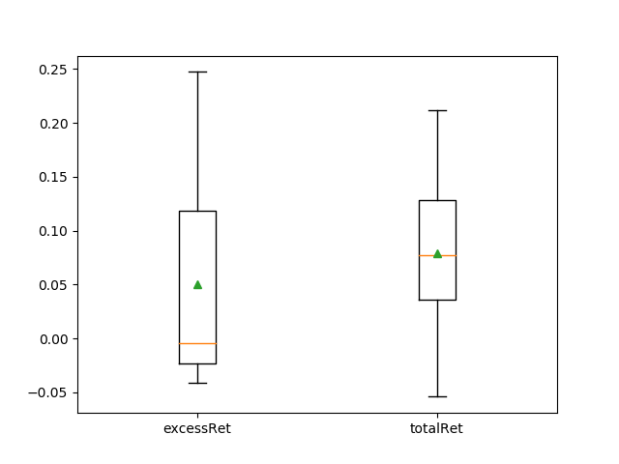
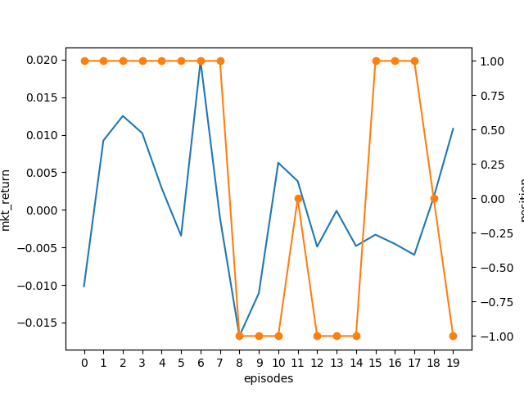
Increase feature set and add costs
Increase the state space to relative changes in prices and volume from T to T-4, and also add the last position to the state space (9 features)
Add cost of 0.1% for each trade
steps

Slide 28
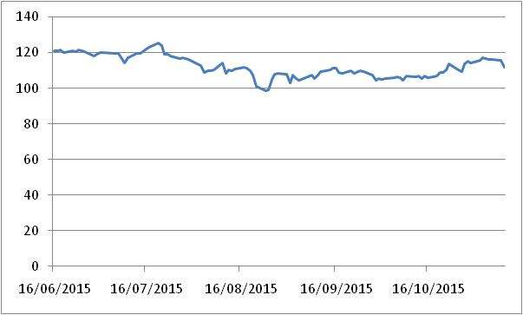
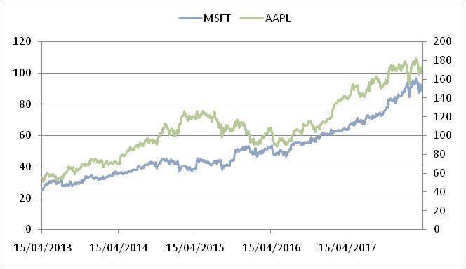
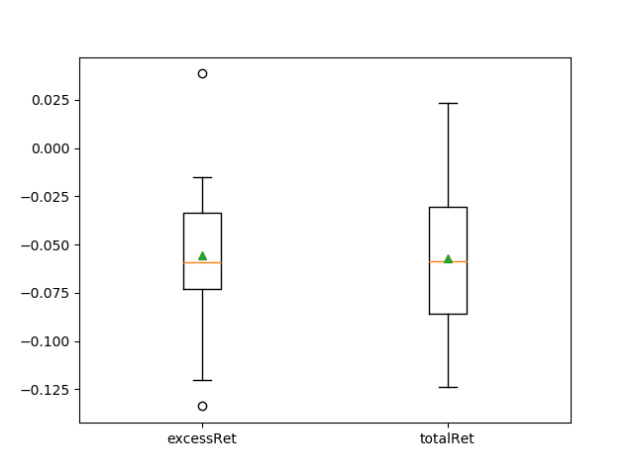
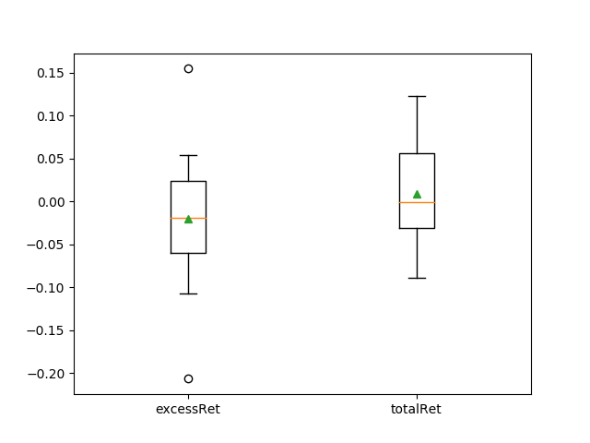
Out of sample performance
AAPL from 2015-06 to 2015-11
MSFT, 20 random months from
2013-03 to 2018-03

Slide 29
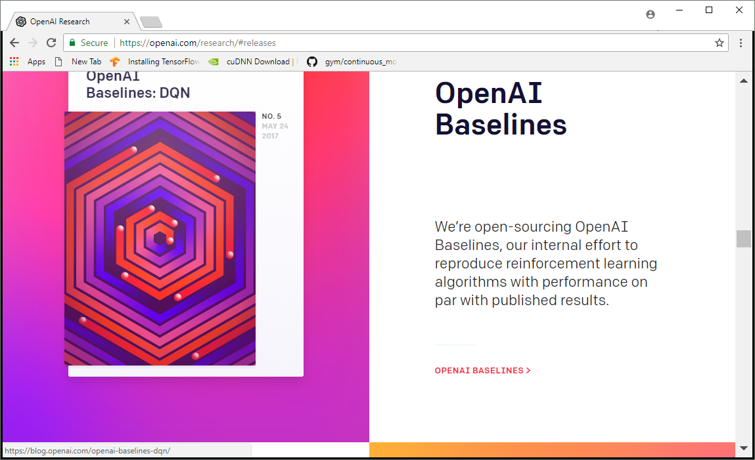
Future…
RL is getting more attractive
Standardization of agent implementations will make more agents accessible
OpenAI Baselines
rllab

Slide 30
RL from another angle
…. Stanford University Professor, Sridhar Mahadevan
Can we make machines not only learn from trial and error but through a prescription, recipe
Chef learns cooking initially by following recipes. Not everything is written in the recipes, ex size of pan, what oven to use, or what is the order of the ingredients to be mixed, how exactly to chop an onion for the recipe.
If Chef didn’t follow any recipe the restaurant will go bankrupt till the chef cooked something edible. Or we will never learned how to drive since most people will not be able to afford crashing 1000 cars.
Real environments are not enclosed, still humans able to keep up with it.
Finance is an environment which has many states, and we still have successful human portfolio managers, and traders. They learn by mimicking other successful trades. In addition there are other agents compete with you!
Next leap step in RL is getting out of Markovian environments and trying to mimic human learning a bit more, don’t follow the herd!

Slide 31
References
http://www.cse.unsw.edu.au/~cs9417ml/RL1/algorithms.html
https://dzone.com/articles/reinforcement-learning-overview
Disclaimer ☺
The views and results presented in this presentation are author’s. They don’t represent author’s employers views and opinions

